Slide 1


The Past, Present, and Future of Municipal Representation: A solicitor’s observations and Forecast
LOCAL GOVERNMENT SYMPOSIUM
LOOKING FORWARD: LOCAL GOVERNMENT IN AN EVOLVING LANDSCAPE
Sam Wiser, Salzmann Hughes, P.C.

Slide 2

Looking back
Lessons of the Past

Slide 3
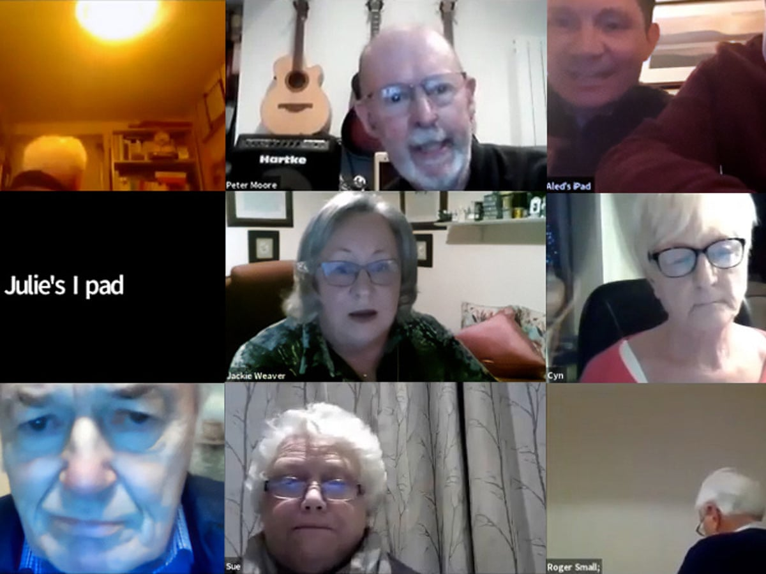
Time flies when you are having fun
In 2020, many local governments were thrust into the digital age. While some communities have maintained a form of digital participation or broadcast, some have happily returned to in-person only meetings.
January will mark the 15th anniversary of the Right-to-Know Law. Communities continue to struggle with commercial requests and fishing expeditions. Transparency comes at a high cost for taxpayers.
It’s been 20 years since DEP began issuing NPDES Permits to “Small MS4” communities. As communities grapple with how to fund stormwater systems, the Borough of West Chester v. Pa. State System of Higher Education case could have a significant impact on the funding structure of many communities.
I’ve learned that, without fail, every few years, the topics of what to do with feral cats and whether chickens should be allowed in residential areas will come up.
I’ve also learned that there are innumerable individuals who volunteer their time for the, often thankless, task of trying to do what is best for their community.

Slide 4

The Present
It’s Electrifying

Slide 5

Utility scale solar
Green Energy on Green Fields
Utility scale solar energy facilities continue to be developed across Pennsylvania. One of the unique characteristics of this land use is the scale of some facilities. It is not uncommon for facilities to be hundreds of acres in size. Many municipalities find it challenging to balance the protection of prime agricultural soils, historical and cultural landscapes, and community character with the need to accommodate their “fair-share” of utility scale solar use.
Residents often express concerns that their communities are burdened with facilities that provide no local benefit. Many of the large projects serve urban populations. In addition, projects often displace productive agricultural uses, removing the properties from agricultural production for a generation or more.
Lightsource bp project in Franklin County:
70 MWs
500 acres
150,000 solar panels

Slide 6
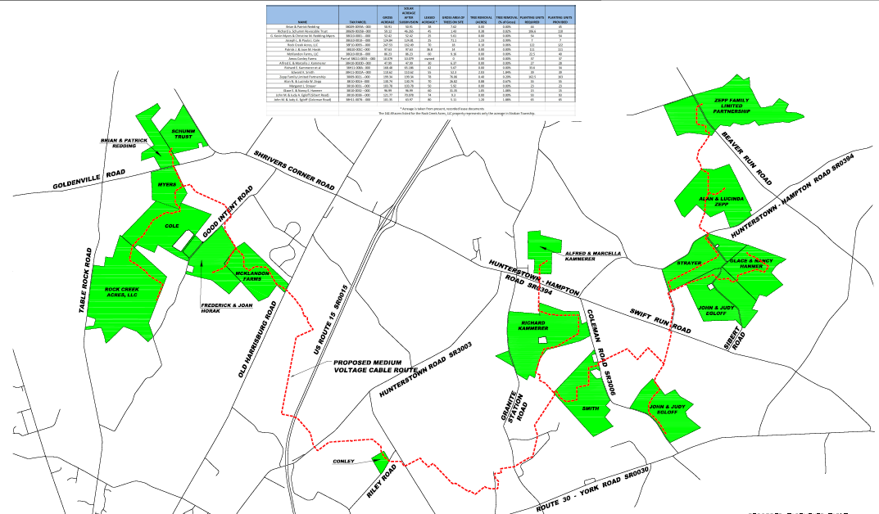
Adams Solar Project - Energix
Straban Township, Adams County
70 MW
16 Farms
850 Acres
Supplies 22% of the City of Philadelphia’s electric needs!

Slide 7
Granite Hill Solar Project – Lightsource bp
Straban Township, Adams County
4 Farms
1,046 Acres
70 MW

Slide 8


Comparison slide
THE CHALLENGE
Legislative Action
Many sparsely populated municipalities do not have the resources to proactively develop solar regulatory tools (zoning, SALDO, SWM).
Because utility scale solar is an emerging use, there is little caselaw to guide setbacks, buffering, coverage requirements, etc.
There are no incentives for rooftop applications or brownfield use.
HB 925: establishes decommissioning requirements for solar energy facilities and preempts local decommissioning requirements.
SB 798: prohibits solar energy facilities on Class 1 or 2 agricultural soils. Provides incentives for facilities located on brownfields and rooftops.

Slide 9

EV CHARGING
Plugging into the EV Transition
Many zoning ordinances are silent regarding EV charging facilities as a permitted or accessory use. Few incorporate requirements for new construction to include EV charging.
Some modern zoning ordinances specify the level of EV charging facilities that are required with different land uses (specifying percent of parking to be dedicated to EV or made ready for future EV use).
Given that most EV users prefer at home charging, EV infrastructure is particularly difficult to address where only on-street parking is available. Addressing charging facilities within the public right of way is a hurdle to universal EV use.
The Pennsylvania UCC does not require EV charging installation or make-ready. HB 833 seeks to incorporate EV charging requirements into the UCC for new non-residential buildings.

Slide 10

The revolving door
Recruiting and Retaining Qualified Management Staff in Small Communities

Slide 11
Management turnover is costly
Contracted management type services are nothing new to small communities. Many communities with water or sewer systems engage circuit riding operators who oversee the operations of those facilities while the municipality provides on site labor.
Maryland provides funding for the Maryland Town Manager Circuit Rider Program, to assist small communities in meeting their administrative needs. There are other states that provide for circuit riding local government managers as well.
With 2,560 municipalities in Pennsylvania, the vast majority of which have less than 5,000 residents, the revolving door is a reality for many of them.
Consistency is Key, but Hard to Come By.
Frequent turnover in the manager position is a growing concern for small communities. The applicant pool for these communities is often limited by the compensation they can offer. As more experienced managers retire, and less young people are pursuing careers in local government, the applicant pool is alarmingly small.
Small communities are often stepping-stones for young managers. They will often gain some initial experience and then move on to other opportunities. This revolving door of inexperienced management often inhibits the completion of long-term initiatives, cohesiveness of the workforce, and consistency in community engagement. Inexperienced management can open the Borough up to potential claims that might otherwise be avoided by an experienced manager.
Who can serve as a Second Class Township Manager?
53 P.S. 1301(a)
“the board of supervisors shall appoint one person to fill the office.”

Slide 12
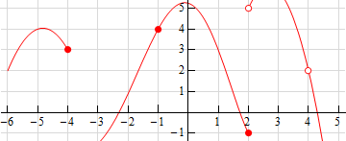
Comparison slide
THE CHALLENGE
Legislative Action
Small communities have limited resources to compensate managers and administrators.
Few young people are getting into the local government field.
Administrative burdens are increasing through governmental mandate.
Lack of continuity in management stimies community growth.
SBs 749, 765, and 774 would allow a municipal manager to be an individual, partnership, association, or corporation.

Slide 13
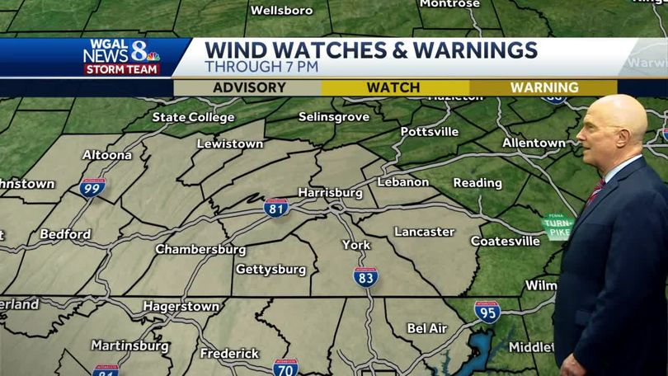
The Forecast
What is Looming on the Horizon?

Slide 14
The end of the line
The Precipitous State of Emergency Service Funding

Slide 15
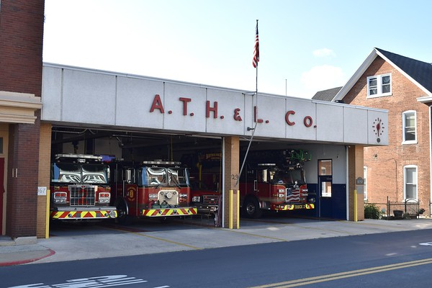
Emergency Service Funding
Few Funding Options for Essential Services
Municipalities that provide police, fire, and other emergency services find it increasingly difficult to fund those services. The largest cost driver is personnel, with wage pressure increasing significantly since the pandemic. The drastic increase in the cost of equipment and vehicles has added further financial strain. Many municipalities are left with the choice of reducing services or a significant tax increase, but what about those municipalities who are on the edge of their taxing authority?
We’ll take a look at the impact that an arbitrary cap on emergency service funding has on communities, particularly where a county assessment is antiquated.
Waynesboro Fire Department, Franklin County
The outdated structure barely supports the weight of the fire apparatus and falls far short of meeting current needs.

Slide 16
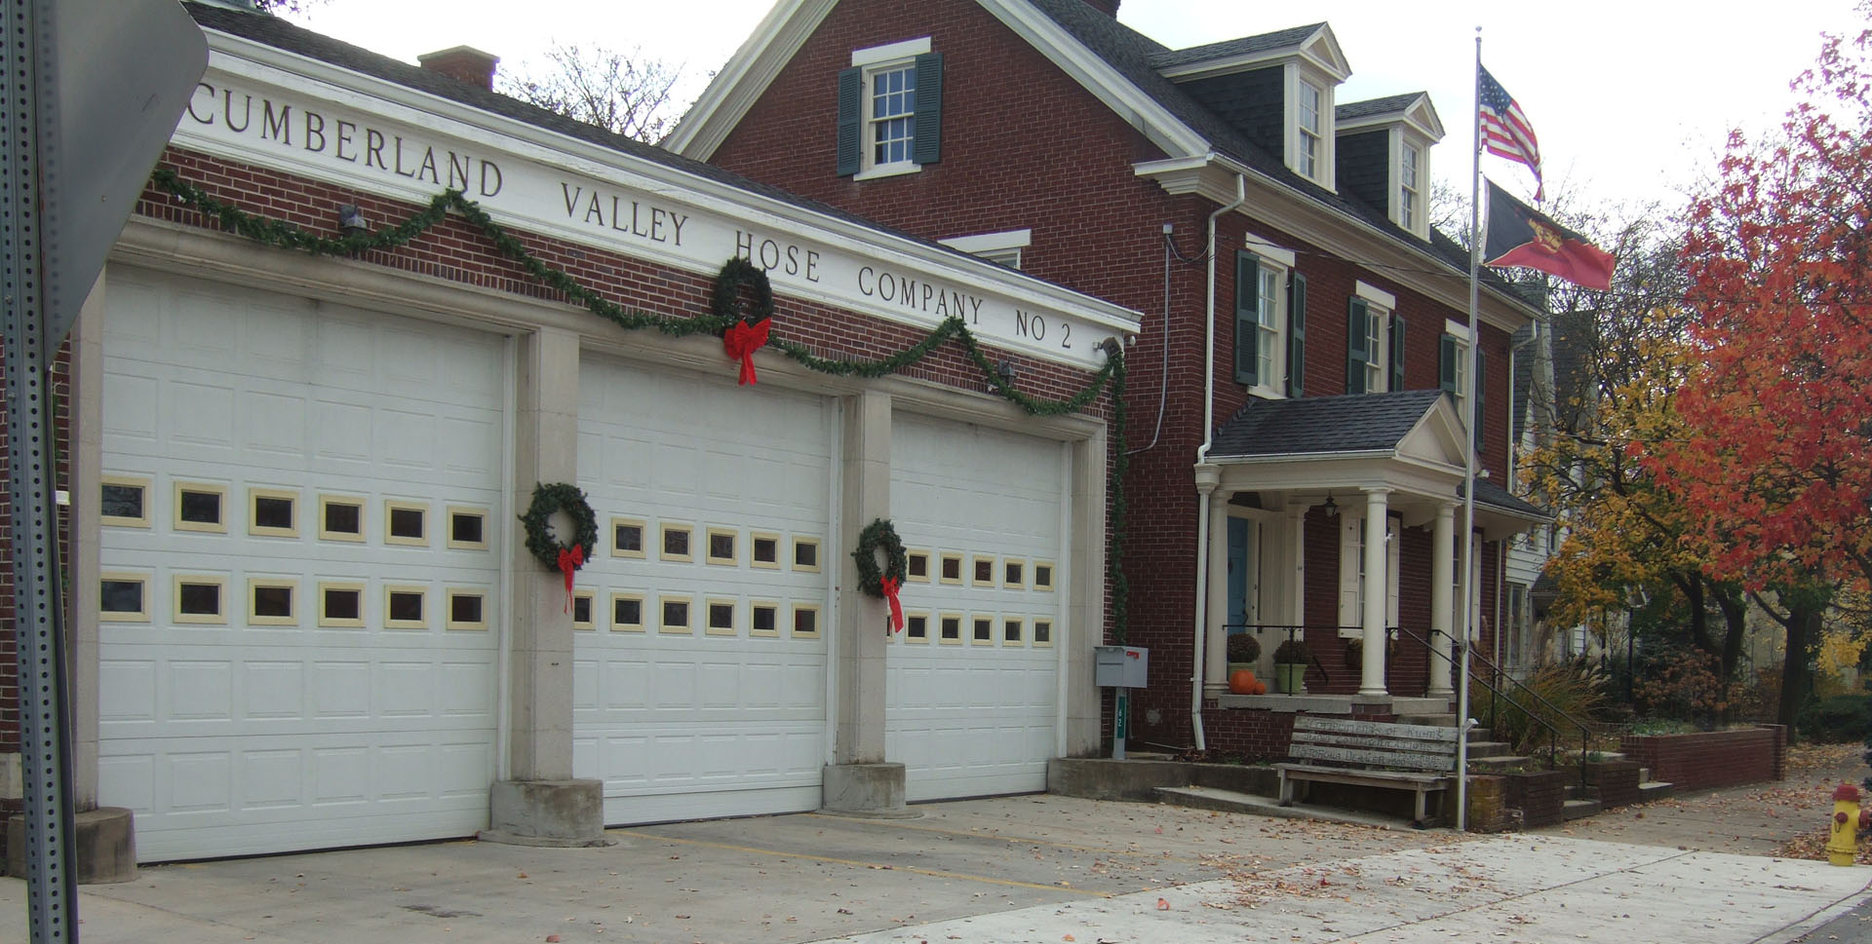
Borough of Shippensburg
A Tale of Two Counties
Shippensburg Borough is located in Cumberland and Franklin Counties. It is a stark example of the impact of an antiquated assessment and arbitrary millage caps. Cumberland County’s last county wide reassessment was in 2010. Franklin County’s last county wide reassessment occurred in 1961.
The value of 1 mill in Cumberland County is $245,577.99
The value of 1 mill in Franklin County is $13,950.64
Shippensburg’s current general millage rate in Franklin County is 26.79 (3.21 mills from the cap). It is 2.583 in Cumberland County.
Shippensburg can generate approximately $150,000 in additional general tax revenue.
Shippensburg struggles to staff the police department of 11 officers. The volunteer fire companies serving the Borough are putting personnel on the payroll to provide emergency response. The EMS provider finds it difficult to keep up with the call volume and has requested funding from the Borough for staffing. With the millage cap looming, the Borough has few choices other than paring back services.
ARBITRARY LIMITS IN THE BOROUGH CODE:
1302(a)(6) Limits fire funding to 3 mills – Not more than 1 mill can fund salaries and benefits of firefighters
1302(a)(9) Limits EMS funding to 0.5 mills – Not more than 0.25 mills can fund salaries and benefits of EMS personnel

Slide 17
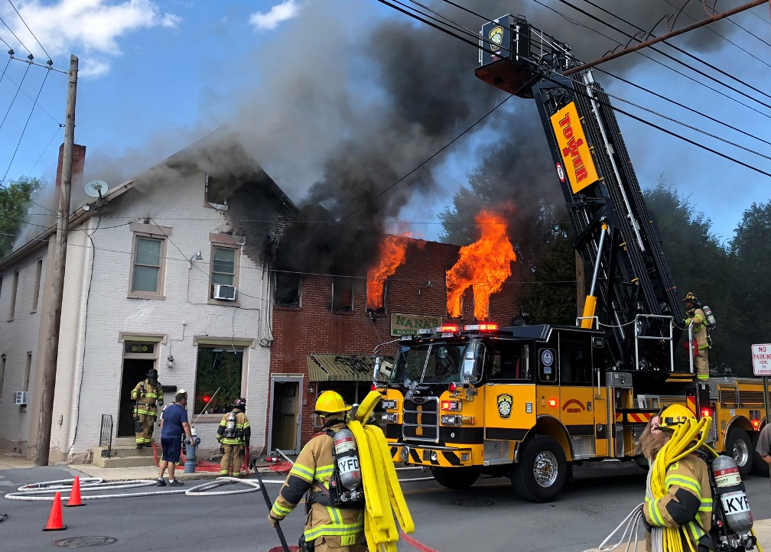
Borough of CHAMBERSBURG
The Borough assesses the 3 mill real estate tax for fire service, but to fully fund the fire department would require 31 mills and an additional 3.25 mills would be needed for EMS.
The 2023 Fire/EMS Department Budget is $5,670,265.
The current cost of a new ladder truck: $2M+.
The value of 1 mill in Chambersburg is $210,000.
The Cost of Paid Services
Chambersburg Borough has a 37 member police department, a 35 member paid fire department, and the Borough provides EMS services.
This year the EMS operation is projected to run a deficit of $1.3M (costs not covered by EMS billing).
The 25 mills of real estate tax are dedicated to the police department (which is projected to fall $423,510 short of operating costs in 2023 – equivalent to a 2 mill funding shortfall).
The 2023 Police Department budget is $6,650,710.

Slide 18
Value of a Mill
A Vast Chasm in Value
Municipality | Type | County | Value of 1 mill
Lower Merion | Township | Montgomery | $7,780,358
Upper St. Clair Township | Township | Allegheny | $2,350,000
Monroeville | Borough | Allegheny | $2,300,000
Montgomery | Township | Montgomery | $2,175,290
Upper Gwynedd | Township | Montgomery | $1,692,123
Upper Moreland Township | Township | Montgomery | $1,548,000
Fairview Township | Township | York | $1,413,235
Salisburg | Township | Lehigh | $1,319,445
Fox Chapel | Borough | Allegheny | $1,231,000
Penn Township | Township | Lancaster | $893,914
Lansdale | Borough | Montgomery | $812,512
Amity | Township | Berks | $735,550
Oakmont | Borough | Allegheny | $593,461
Middletown Township | Township | Bucks | $520,000
Gettysburg | Borough | Adams | $506,783
Forest Hills | Borough | Allegheny | $383,633
Doylestown | Township | Bucks | $275,013
Chambersburg | Borough | Franklin | $210,000
Loyalsock Township | Township | Lycoming | $180,000
Butler | Township | Butler | $163,274
Etna | Borough | Allegheny | $95,000
Halfmoon Township | Township | Centre | $81,508
Ambridge Borough | Borough | Beaver | $58,152
Shippensburg Borough | Borough | Franklin | $13,950

Slide 19
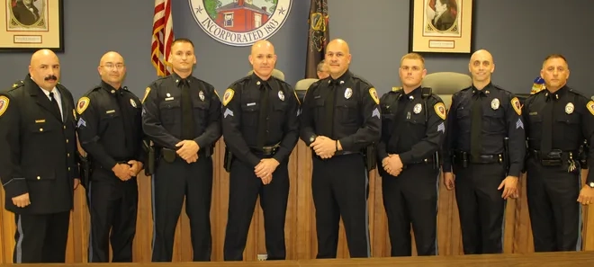
Comparison slide
THE CHALLENGE
Legislative Action
Arbitrary caps limit funding options.
Antiquated assessments inhibit necessary funding for essential services.
“Natural growth” in millage values is far outstripped by inflation.
Senator Farry has proposed legislation to remove the arbitrary cap on fire millage.
Senators Farry and Brooks have proposed legislation to increase Medicaid reimbursements for transports.
HBs 1035, 1036, and 1037 propose an increase in EMS tax cap from 0.5 to 1.5 mills.

Slide 20
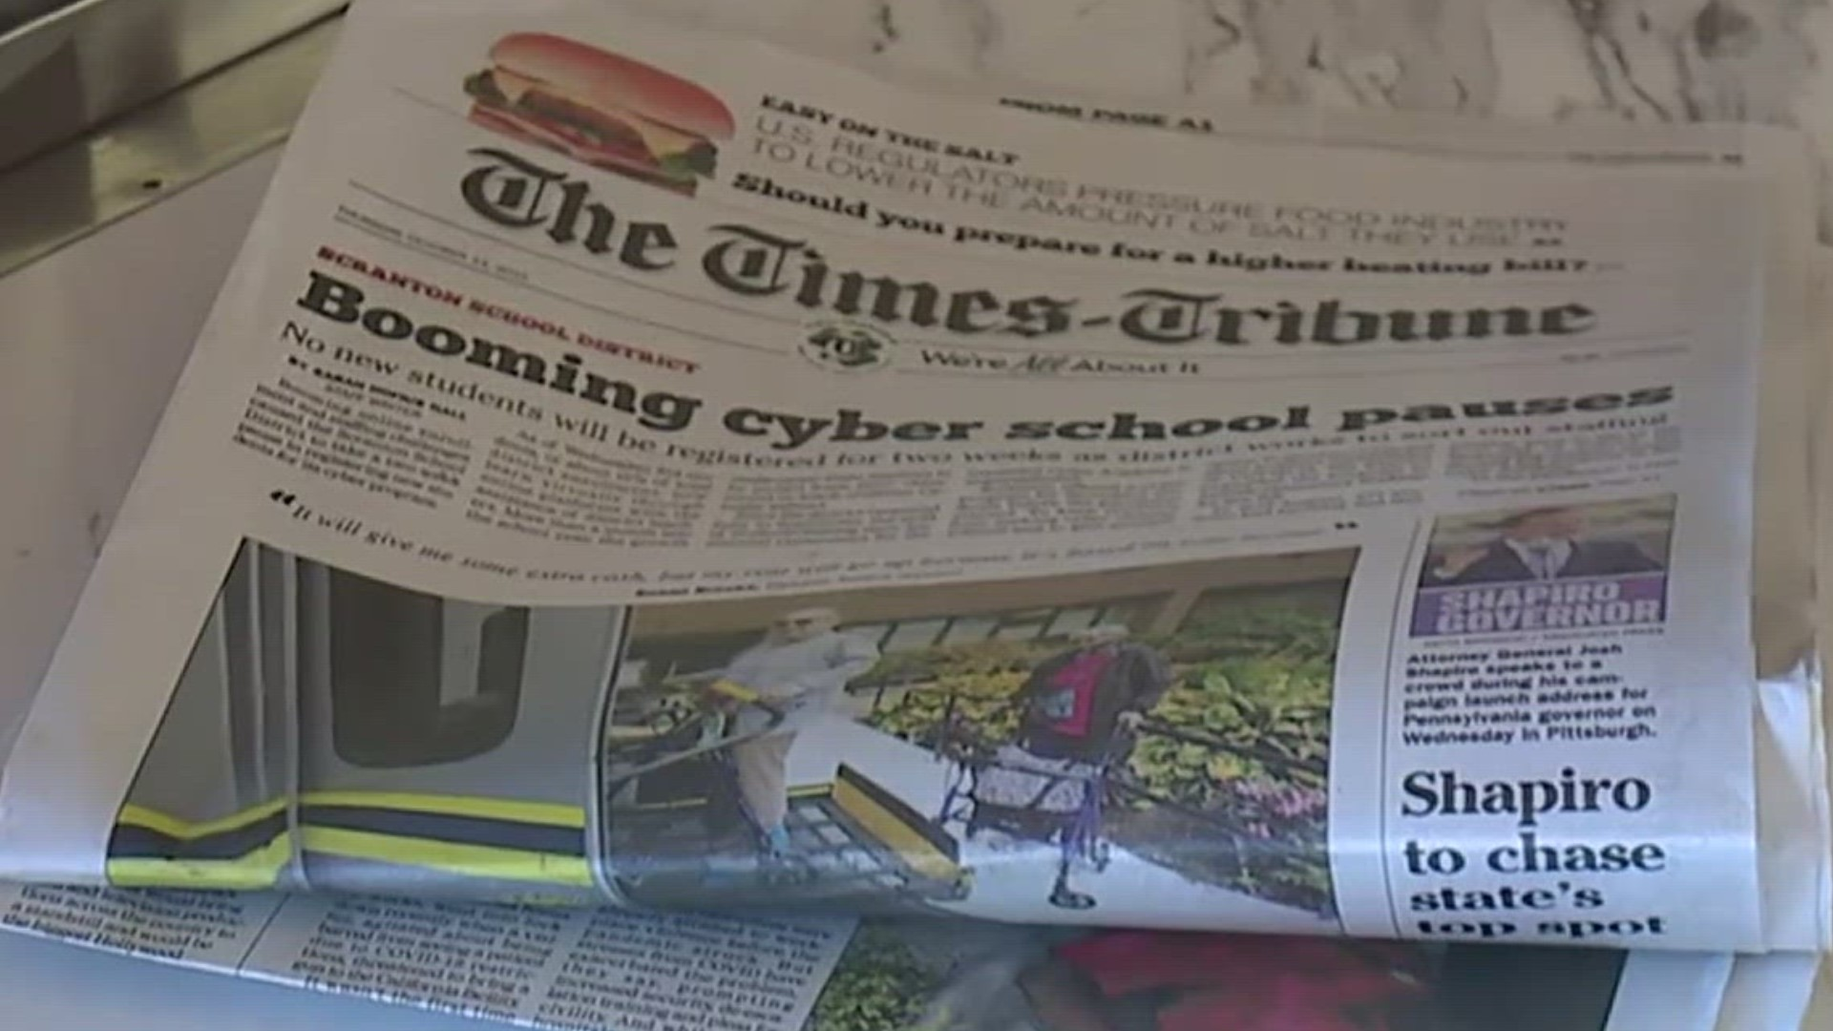
Running out of options
Advertising Requirements Difficult to Meet

Slide 21
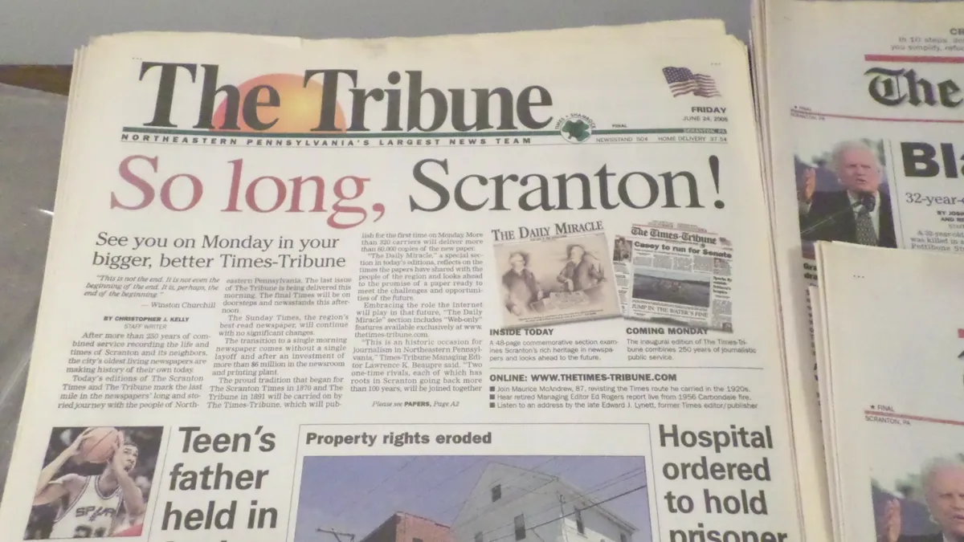
Newspapers of general circulation
Not Circulating Like They Once Were.
More and more municipalities are faced with a lack of advertising options. The enabling codes still require publication of notices and ordinances in a newspaper of general circulation. Many publications have scaled back the number of days that they issue print editions or have gone to a complete or partial digital format. Advertising in the digital edition does not satisfy existing advertising requirements.
The Pew Research Center noted that newspaper circulation in the U.S. was at 56 million in 2020. Today, it’s less than 25 million.
What is a newspaper of general circulation?
45 Pa.C.S.A. 101
Issued daily, or not less than once a week
Intended for general distribution and circulation
Sold at fixed prices per copy
Sold to subscribers and readers without regard to business, trade, profession, or class.

Slide 22

Comparison slide
THE CHALLENGE
Legislative Action
Newspapers are closing or switching to digital editions.
Circulation has decreased dramatically.
Strikes, equipment breakdowns, and supply chain issues interrupt service.
SB 231 would allow municipalities to publish notice
  In a newspaper of general circulation; or
  On the municipality’s website; or
  On a publicly accessible internet website of a newspaper, or any other publicly accessible website having the main purpose of posting advertisements/notices.
    If utilizing options 2 or 3, there are additional positing and resolution requirements.
The local government is still required to publish notice in a legal journal.

Slide 23
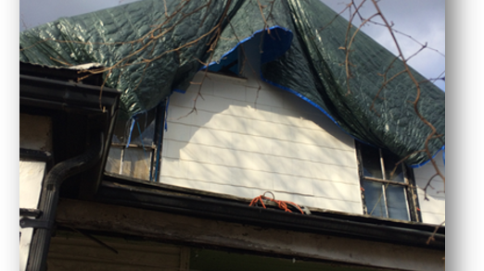
Evolving expectations
Second Class Townships Grapple with Code Enforcement

Slide 24
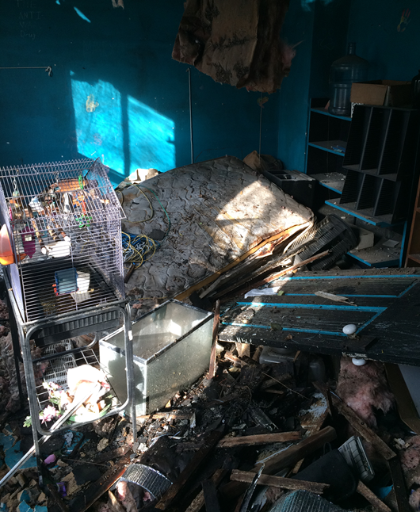
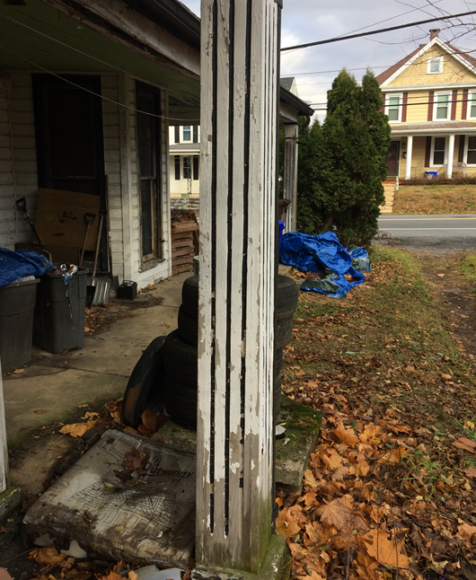
Tackling blight in rural areas
Demand for Code Enforcement Increases with Population Increases
As Second-Class Townships see an influx of residents from more urban areas with higher service level expectations, many Townships have had to grapple with how to address an increasing number of code enforcement issues. The rise in code enforcement matters is also attributable to a rising number of unaddressed mental health issues.
For many Second-Class Townships, the adoption of a comprehensive property maintenance code, such as the IPMC, is viewed as too radical a move. Most Second-Class Townships rely on their nuisance ordinance(s).
While the First-Class Township Code and the Borough Code contain similar language regarding nuisances, the Second-Class Townships lack the same authority. The difference is:
A SCT is not expressly authorized to remove a nuisance (unless it’s a dangerous structure)
The other codes expressly permit that a penalty of 10% be added to the cost of removal of the nuisance
Having those additional tools available would assist Second Class Townships in their enforcement efforts.

Slide 25

Its not all doom and gloom
Municipalities have weathered the pandemic fairly well. ARPA funds (state and local) have facilitated some initiatives that may not have otherwise occurred. Revitalization and economic development are on the horizon for those municipalities that have leveraged historic public funding for infrastructure and quality of life improvements.
Digital engagement is generally not a strong suit of most municipalities, but municipalities are becoming more adept at navigating digital platforms, which may result in increased interest in elected and appointed positions and building trust in local government.

Slide 26
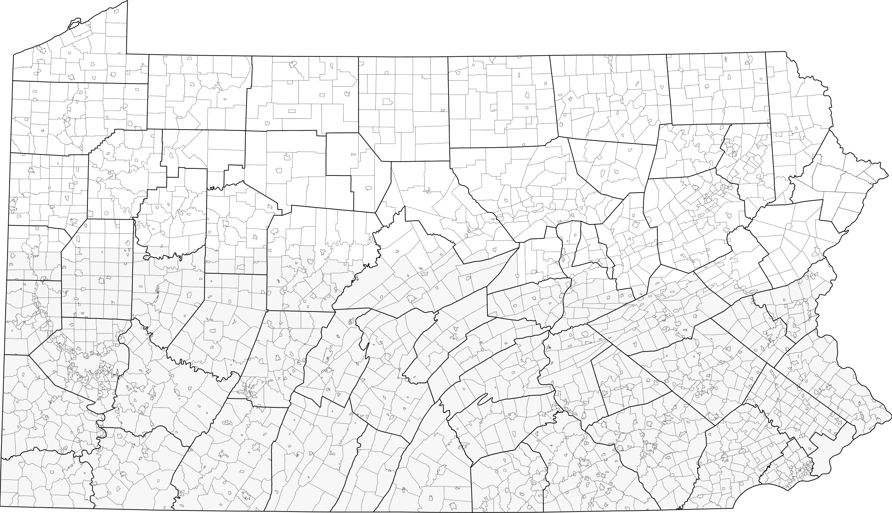


THANK YOU FOR YOUR TIME
Samuel E. Wiser, Jr.
Shareholder | Salzmann Hughes, P.C.
Salzmann Hughes, P.C.
Chambersburg, PA 17201
Ph: (717) 263-2121
Email: swiser@salzmannhughes.com
www.salzmannhughes.com

Slide 27


Samuel E. Wiser, Jr.
Shareholder | Salzmann Hughes, P.C.
Salzmann Hughes, P.C.
Chambersburg, PA 17201
Ph: (717) 263-2121
Email: swiser@salzmannhughes.com
www.salzmannhughes.com

Slide 28

ABOUT OUR MUNICIPAL PRACTICE GROUP
More than 20 attorneys active in Municipal Practice Group
Represent over 100 municipal entities in PA
Provide legal guidance to boroughs, townships, counties, municipal authorities, and other local government entities
Our Municipal Practice Group reduces the need to rely on special counsel arrangements.

Slide 29

MUNICIPAL PRACTICE GROUP SERVICES
ARPA Eligibility/Compliance
Land Development and Zoning
ROW Acquisition
Eminent Domain
Environmental Compliance
Utility Operations and Improvements
Code Enforcement
Municipal Collections
Collective Bargaining
Personnel Procurement Contracting
Employment Matters
MS4 Implementation

