Slide 1

Wheatland Borough and City of Hermitage Merger
Local Government Commission Symposium
October 19, 2023

Slide 2

Wheatland Borough
Historical Overview
Mercer County municipality incorporated in 1872
0.9 square miles
Near Ohio border approximately 70 miles northwest of Pittsburgh
Operated under state Borough Code with seven-member council and weak mayor structure
Historically, three full-time employees including full-time secretary-treasurer and public works
Other services including police provided by contract with neighboring municipality or third- party vendor

Slide 3
Wheatland Borough
Demographics
Population drop between 1980 and 1990 coincides with 1985 tornado
Wealth measurements lower than county and state

Slide 4
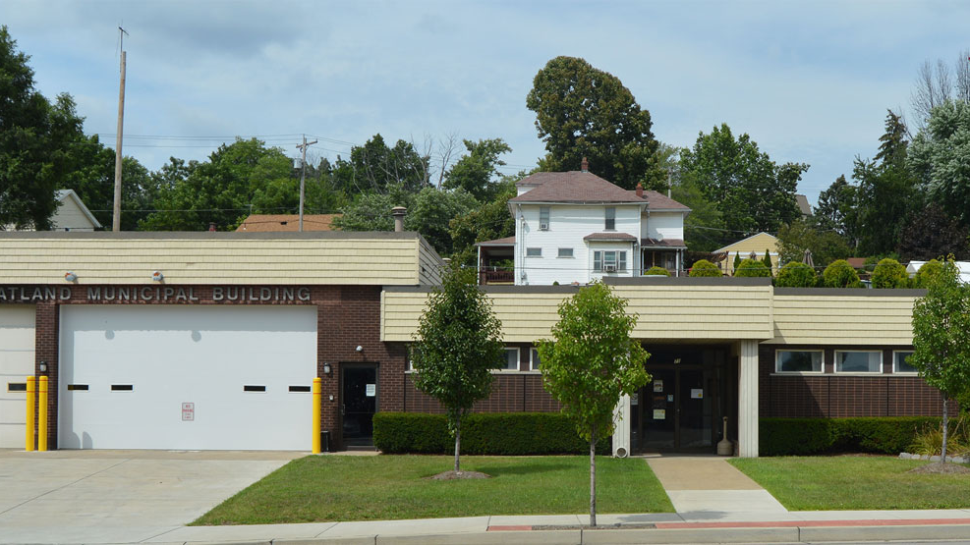
Merger Phase I
2017 to 2018

Slide 5
Wheatland Borough
PEL Early Intervention Process 2017
Entire public works two-person crew resigned
Deficits in four out of five prior years
20% decline in tax revenue over period
  Property tax revenue fell from 2015 to 2016 despite 2015 millage increase
  Large decrease in EIT due to industry closure
Expenditure increase driven by health insurance up 55%

Slide 6
Wheatland Borough
EIP Projections, 2018 to 2022

Slide 7
Wheatland Borough
Key EIP Recommendations
Contract with neighboring city of Hermitage to provide public works services
  Hermitage already contracted for police
  DCED provided three-year grant to assist with costs
Consider home rule for tax flexibility
  EIT declined because of industry closure but generally grows more than property taxes
  Ohio residents working in the borough pay EIT

Slide 8
Merger Phase II
2019 to 2021

Slide 9
Wheatland Borough
EIP Implementation
Received $100,000+ STMP grant to contract public works services from Hermitage
  Funded at 75%, 50% and 25% of costs over 3 years
  Reduced service costs improved finances
Approved home rule charter
  Resident EIT raised from 0.5% to 1%
Staff reduced to one part-time secretary
All services are outsourced
Surpluses develop and fund balance increases
Improved borough finances make it an attractive merger partner

Slide 10

Wheatland
Long Term Financial Concerns 2021
Real estate tax collection rates declined slightly as rates increased.
Flat property assessment trends meant no natural growth in borough’s largest revenue source.
  Total assessed value in 2020 was lower than in 2005
End of DCED grant funding.
  Offset $122,500 of expenditures over 3 years.
History of General Fund spending needed to offset limited sewer revenues for pump station/system repairs.

Slide 11
Merger Phase III
2021 to 2022

Slide 12

Wheatland Borough and City of Hermitage
Merger Study
STMP Phase III grant used for merger study
Reviewed historical financials and projected financials
Examined implications to other services like fire and refuse
Discussed history of mergers, challenges and factors for success
Reviewed assets of the two communities
Made public presentations to the Hermitage and Wheatland communities
Officials from both municipalities were supportive of process and spoke in support at the public meetings

Slide 13
Difference in Tax Structure
Tax | Wheatland | Hermitage
Real Estate Tax - General Purpose (mills) | 22.92 | 5.00
Real Estate Tax - Pensions and Retirement (mills) | 0.50 | -
Real Estate Tax - Street Lighting (mills) | 1.33 | -
Real Estate Tax - Total (mills) | 24.75 | 5.00
Earned Income Tax - Resident (%) | 1.00 | 1.75
Earned Income Tax - Nonresident (%) | 1.00 | 1.00
Local Services Tax ($) | 47.00 | 47.00
Realty Transfer Tax (%) | 1.00 | 1.50
Per Capita Tax ($) | 5.00 | 20.00
Mercantile/Business Privilege Taxes - Flat Rate ($) | - | 200.00
Mechanical Devices Tax ($) | 50.00 | 50.00
Occupation Tax ($) | 5.00 | -
Notes:
Of most importance to Wheatland residents with regards to a potential merger is the tax implication.
The reduction in RE tax and increase for EIT means every household has a different impact, which we’ll get into in more detail shortly.
Per capita is also higher in Hermitage.
The impact on Wheatland businesses is also variable depending on the nature of their business (e.g. are they subject to the flat $200 BP/mercantile tax) versus their real estate tax decrease.

Slide 14
Wheatland
Real Estate Tax and EIT Implications
Real Estate Taxes
Savings for property owners, residential and non-residential (e.g., commercial and industrial)
No direct impact on renters
Earned Income Taxes
Higher EIT for Wheatland residents with earned income.
No impact on income derived from Social Security or retirement disbursements (e.g., pensions, 401(k), etc.) which are not taxable via EIT.
No impact on Ohio commuters paying non-resident EIT.
Notes:
The tax savings to the owners of these residential parcels in the middle 50 percent are between $169 and $255 based on the current Wheatland and Hermitage millages.
The Census American Community Survey also allows us to roughly estimate the middle 50 percent of household income to be between $20,000 and $50,000.
Assuming all of that income is taxable, that would

Slide 15
Wheatland Borough Merger Benefits
Larger Tax Base
  Hermitage has not raised property taxes in 31 years
  Consolidates existing industrial corridor in one municipality
  Attract new development with lower property taxes
Access to City Services
Library, parks and recreation
Professional municipal management
Volunteer Fire
  Anticipated to come under Hermitage fire umbrella
  Can retain name
  Training improvements
Notes:
$59.94 per quarter (+$20 quarterly compared to current contract with fewer services).

Slide 16

Wheatland Borough
Merger Benefits
Sanitation
Same vendor (Tri-County Industries)
Slightly higher price for higher service level
Service includes three 95-gallon toters
  One garbage, one recycling, one yard waste
Recycling services included
Option for smaller toters at slightly reduced price
Notes:
$59.94 per quarter (+$20 quarterly compared to current contract with fewer services).

Slide 17
Wheatland Borough
Areas of Consistency
Same School District
Same Mailing Address/Post Office
Planned use of Wheatland Borough Hall/Fire House
“Wheatland” identity and branding will not disappear

Slide 18
City of Hermitage Merger Impact
General Fund Impacts
Added tax base and state liquid fuels funds will exceed the combined impact of:
Lost revenue from police & public works contracts.
Extra expenditures for maintenance, repair, and insuring transferred capital assets.
Capital Fund and Sewer
Additional ~$40,000 in Local Service Tax (LST) revenue annually based on current employment within Wheatland.
Added revenues will likely outpace anticipated expenditures by between $10,000 and $90,000 annually
Additional ~ $25,000 - $30,000 in sewer charge revenues to fund pump station operating expenses and conveyance system capital costs.
Notes:
Based on preliminary analysis, we believe the added tax base and liquid fuels allocation will positively impact Hermitage’s General Fund.
Even after the lose of contracted service revenue and the additional costs borne post-merger.
Furthermore, with current employment located in Wheatland, the roughly $40,000 in LST revenues would be added to Hermitage capital funds, which is where the city currently appropriates these revenues.

Slide 19

Merger Process
Merger process by joint agreement of Wheatland and Hermitage
Joint Agreement requirements
  Name, boundaries, class of merged municipality
  Financial arrangements
  Develop transition plan and schedule for elected officers.
  Provide for common administration and uniform enforcement of ordinances.
  Provide for uniform tax system.
A public referendum on the joint agreement takes place at least 13 weeks after approval by the governing bodies.
Joint agreement placed on the November 2022 general election ballot.
Municipalities continue to be governed as before merger until the date stipulated in the transitional plan and schedule provided for in the joint agreement.

